Slide 1

ECE 4715- Machine Learning Final Project Presentation
By: Victor Mendoza and Hogan Leu
GitHub: HTTPs://github.com/hoganleu/Machine-Learning

Slide 2
Introduction
Background and Importance
Heart disease is one of the leading causes of death globally. Early prediction and diagnosis can significantly improve patient outcomes and reduce healthcare costs. Machine learning techniques offer a promising approach to analyze medical data and provide accurate predictions, enabling timely interventions.
Project Objectives
Implement and compare multiple machine learning models, including Random Forest, SVM, Logistic Regression, and Deep Learning (MLP).
Evaluate the performance of these models on two datasets: heart.csv and heart.dat.
Address challenges such as data imbalance and limited dataset size through advanced preprocessing and hyperparameter tuning.

Slide 3

Datasets Overview
This project utilizes two datasets:
heart.csv
Source: Kaggle Heart Disease Dataset.
Features: Contains medical attributes such as age, cholesterol, and heart rate, used for predicting heart disease risk.
Origin: A publicly available dataset first uploaded to Kaggle six years ago.
heart.dat
Source: UCI Statlog Heart Dataset.
Features: Includes similar medical attributes but originates from a different study with fewer samples and imbalanced classes.
Origin: Created in the context of the Statlog project, likely established in 2018.

Slide 4
Datasets Parameters Overview for heart.csv
heart.csv Parameters
The heart.csv dataset includes 14 features relevant to heart disease prediction:
age: Patient's age.
sex: Gender (1 = male, 0 = female).
cp (chest pain type): Types of chest pain (0: asymptomatic, 1–3: increasing severity).
trestbps: Resting blood pressure (mm Hg).
chol: Serum cholesterol level (mg/dl).
fbs: Fasting blood sugar >120 mg/dl (1 = true, 0 = false).
thalach: Maximum heart rate achieved (bpm).
exang: Exercise-induced angina (1 = yes, 0 = no).
target: Presence of heart disease (1 = disease, 0 = no disease).

Slide 5
Datasets Parameters Overview for heart.dat
heart.dat Parameters
The heart.dat dataset contains features similar to heart.csv but includes multiclass target labels:
age, sex, cp: Patient's age, gender, and chest pain type.
trestbps, chol: Resting blood pressure and cholesterol levels.
thalach, exang: Maximum heart rate and exercise-induced angina.
target: Multiclass labels:
1 = No heart disease.
2 = Presence of heart disease.

Slide 6
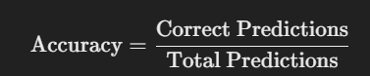
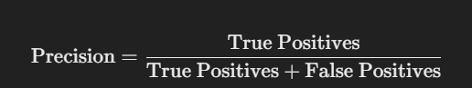


Model Performance Metrics
Accuracy:
Meaning : Accuracy represents the proportion of correct classifications made by the model.
Classification Report :
The classification report includes the following key metrics:
a. Precision: Meaning: Precision measures how many of the samples predicted as a certain class truly belong to that class.
b. Recall: Meaning : Recall measures how many of the actual samples of a certain class are successfully predicted by the model.
c. F1-score: Meaning : F1-score is the harmonic mean of precision and recall, used to measure the overall performance of the model. It is particularly useful when precision and recall need to be balanced.
d. Support Definition : The number of samples belonging to each class. Meaning : Support indicates how many test samples fall into a particular class.

Slide 7
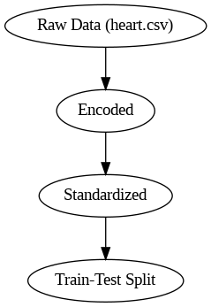
Feature Distribution - heart.csv
Key Observations:
Age: Skewed toward middle-aged individuals, fewer older patients.
Cholesterol: Wide distribution; potential outliers observed.
Heart Rate: Concentration around a specific range, indicating typical physical exertion levels.

Slide 8
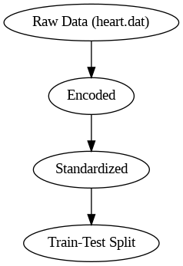
Feature Distribution - heart.dat
Key Observations:
Similar age distribution to heart.csv but with slightly higher representation in older groups.
Cholesterol and heart rate distributions are broader, indicating dataset variability.
Multiclass Target (1 and 2): Highlight potential class imbalance.

Slide 9
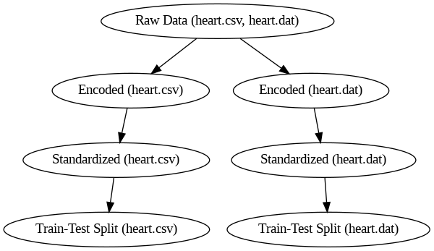
Preprocessing Steps
Techniques Used:
Handling Missing Data:
Both datasets contained no missing values.
One-hot Encoding:
Applied to categorical features (e.g., chest pain type) to convert them into numerical representations.
Standardization:
Features were standardized using StandardScaler for consistent input to machine learning models.
Train-Test Split:
80% training, 20% testing split.

Slide 10
Potential Bias and Challenges
Potential Bias:
heart.csv: May underrepresent older individuals or those with borderline heart conditions.
heart.dat: Multiclass target adds complexity, but imbalanced classes could impact model performance.
heart.dat Challenges:
Multiclass target requires different metrics (e.g., precision-recall for each class).
Broad feature ranges might need further exploration (e.g., binning or transformations).

Slide 11
Baseline Models Overview
1. heart.csv Dataset:
Model: Random Forest Classifier
Features: Encoded and standardized data.
Results:
Accuracy: 98.54%
Precision, Recall, F1-Score: Near 99% for both classes.
Observations: High accuracy indicates good feature quality and minimal class imbalance.
2. heart.dat Dataset:
Model: Random Forest Classifier
Features: Encoded and standardized data.
Results:
Accuracy: 79.63%
Precision and Recall: Lower than heart.csv dataset.
Observations: Moderate accuracy; smaller dataset size and possible class imbalance may impact performance.

Slide 12
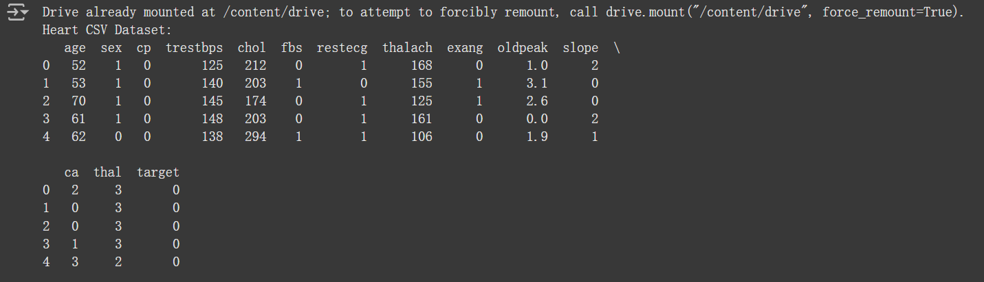
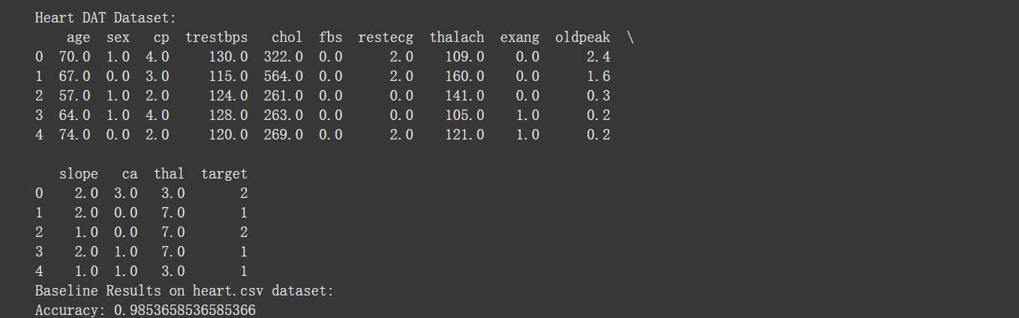

Slide 13
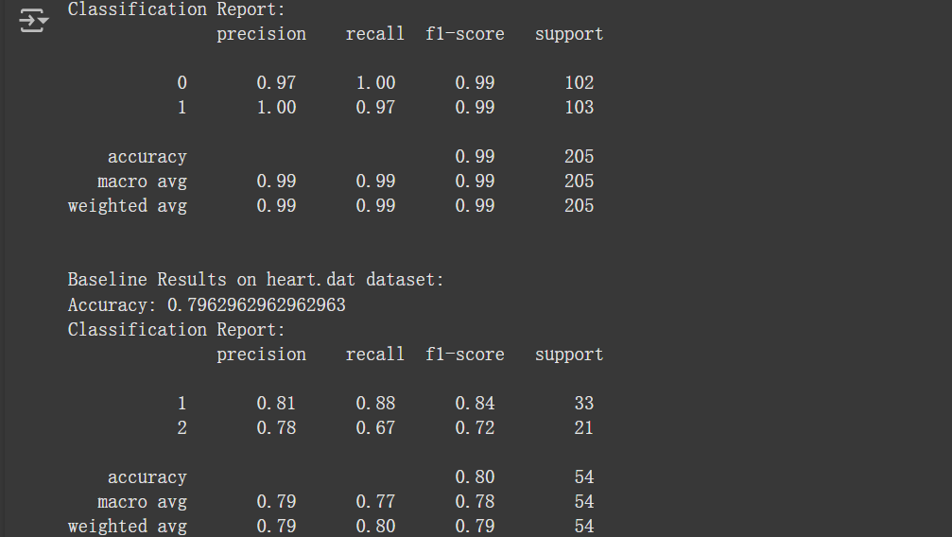

Slide 14
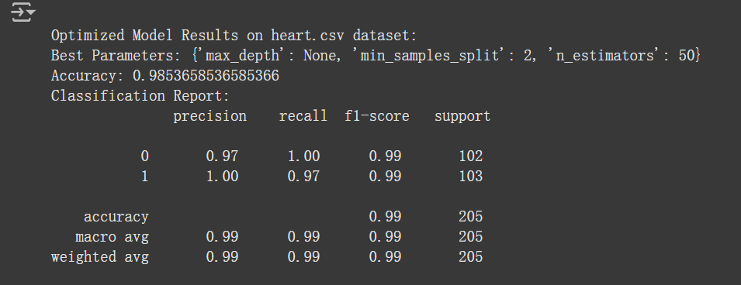
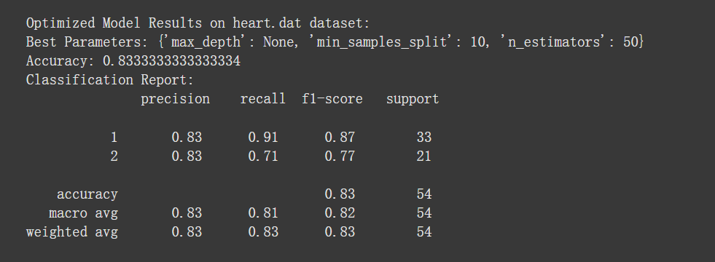

Slide 15
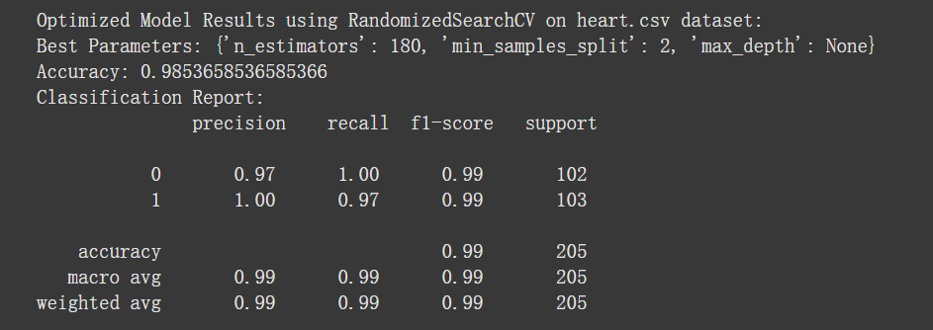
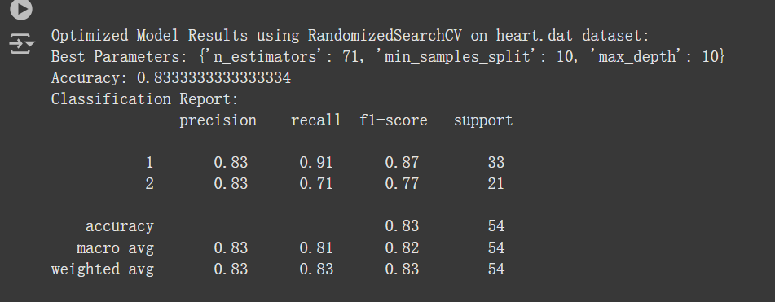

Slide 16
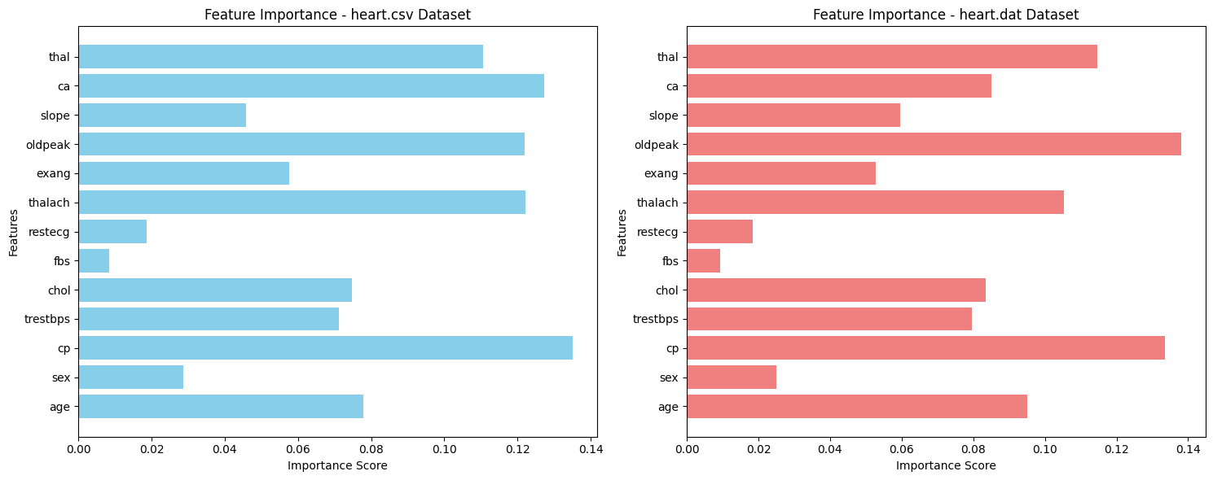
Feature Importance Comparison

Slide 17
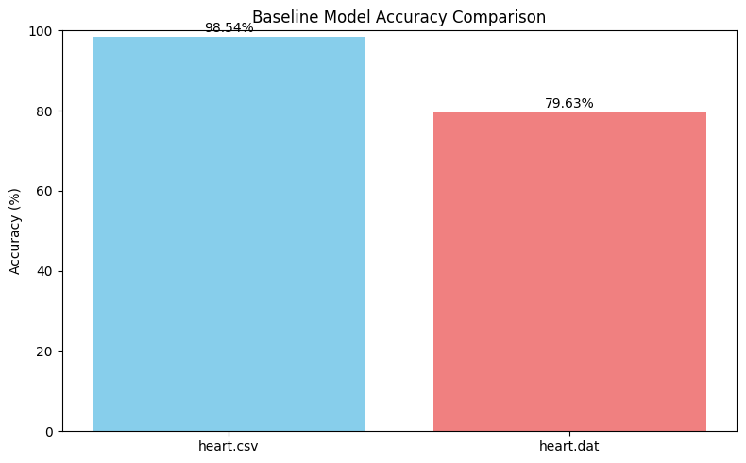
Baseline Results Analysis
heart.csv Dataset:
Accuracy: 98.54%
Precision, Recall, F1-Score: Consistently high (~99%) across both classes.
Observations: High performance indicates:
Well-represented features.
Sufficient data size.
Minimal class imbalance.
heart.dat Dataset:
Accuracy: 79.63%
Precision and Recall: Lower compared to heart.csv.
Observations: Moderate performance suggests:
Smaller dataset size.
Potential class imbalance impacting model predictions.

Slide 18
Model Improvement: Hyperparameter Tuning Overview
1. heart.csv Dataset:
Baseline Accuracy: 98.54%
Optimized Accuracy: 98.54% (No significant improvement due to already high baseline accuracy.)
Tuning Details:
GridSearchCV Best Parameters: {'max_depth': None, 'min_samples_split': 2, 'n_estimators': 50}
RandomizedSearchCV Best Parameters: {'n_estimators': 180, 'min_samples_split': 2, 'max_depth': None}
Observations: Model performance remains robust due to high-quality features and sufficient data size.
2. heart.dat Dataset:
Baseline Accuracy: 79.63%
Optimized Accuracy: 83.33%
Tuning Details:
GridSearchCV Best Parameters: {'max_depth': None, 'min_samples_split': 10, 'n_estimators': 50
}RandomizedSearchCV Best Parameters: {'n_estimators': 71, 'min_samples_split': 10, 'max_depth': 10}
Observations: Moderate improvement achieved.Dataset size and class imbalance still limit performance.

Slide 19
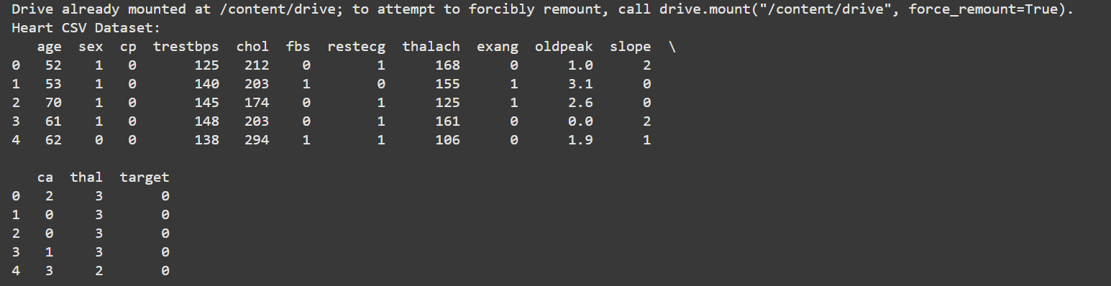
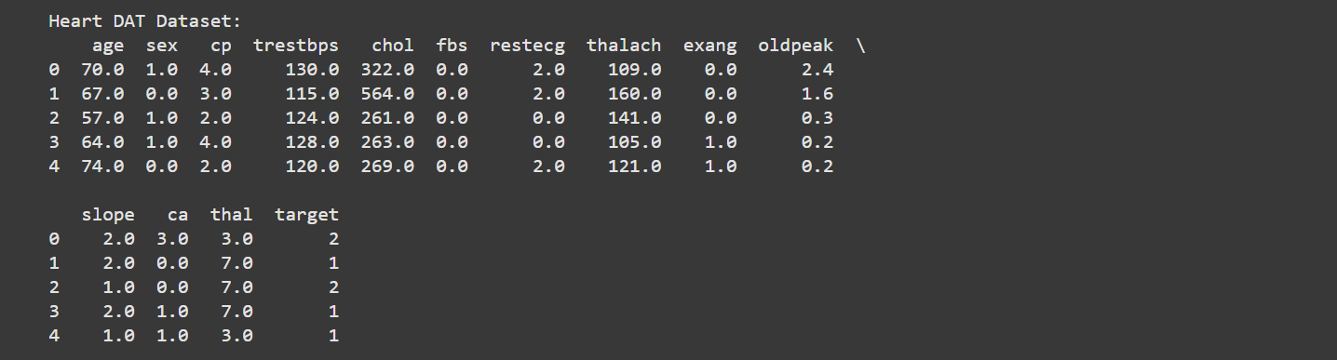

Slide 20
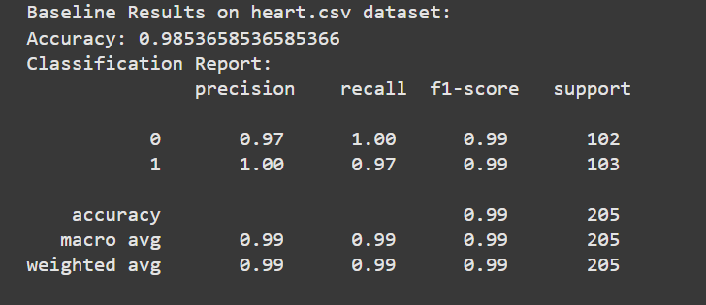
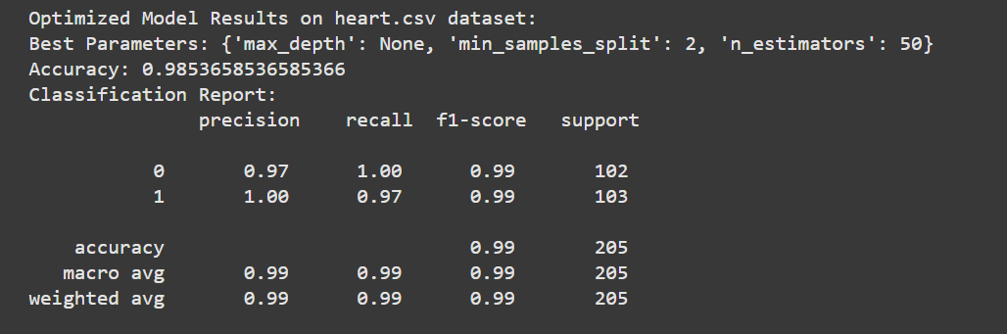

Slide 21
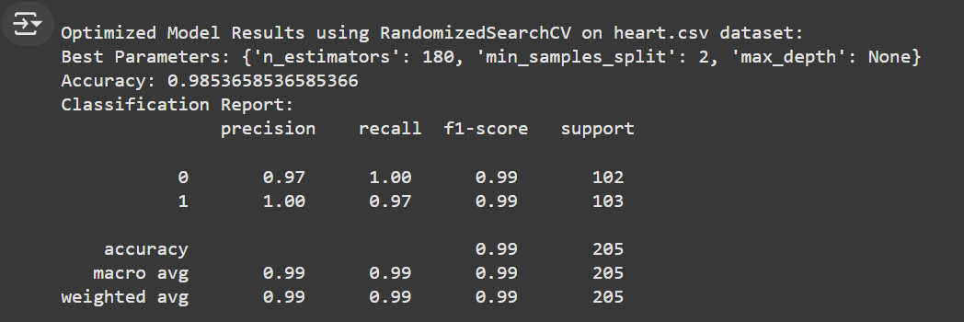
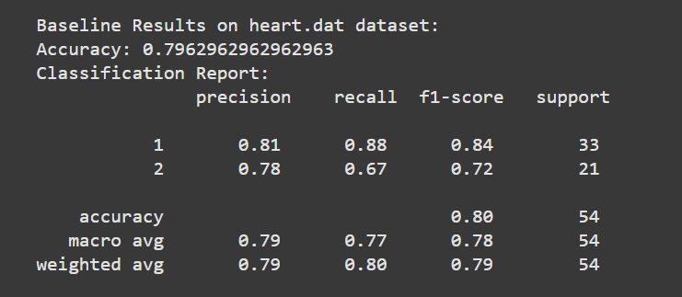

Slide 22
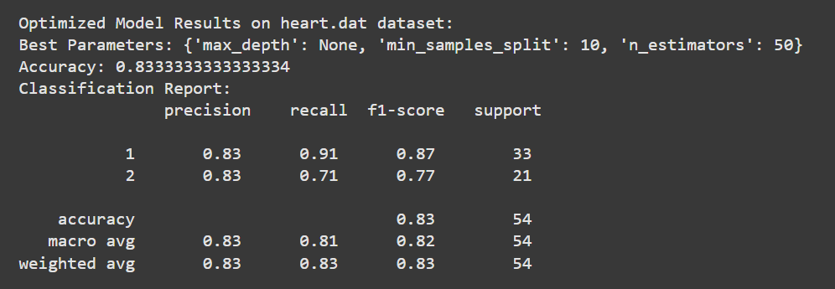
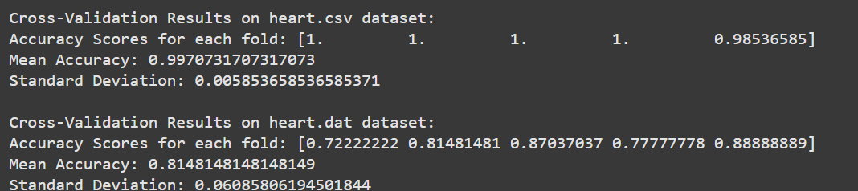

Slide 23
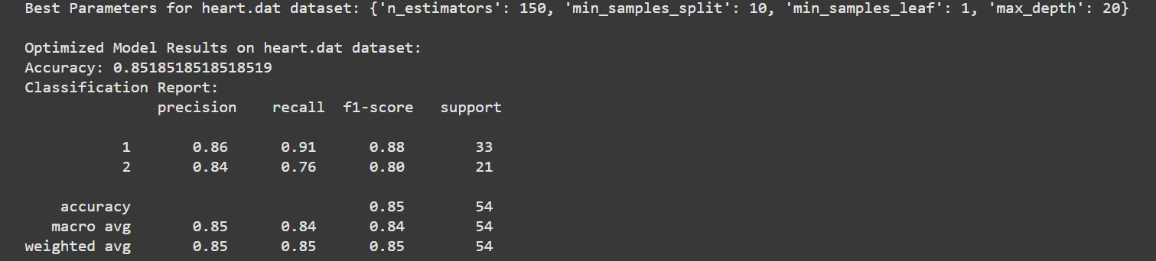

Slide 24
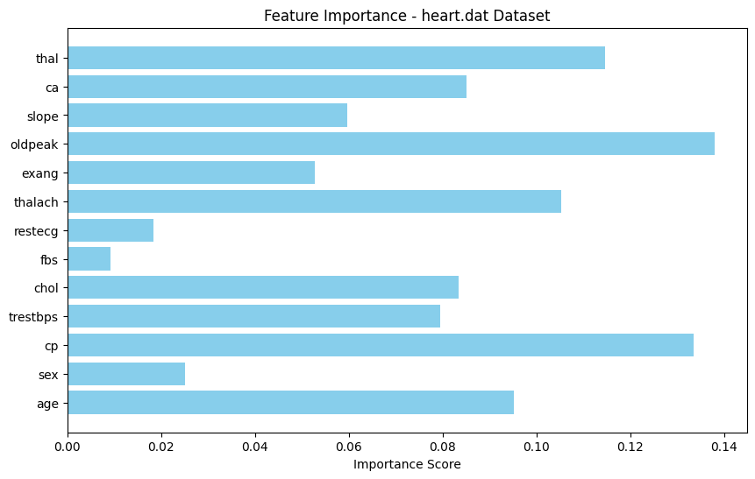
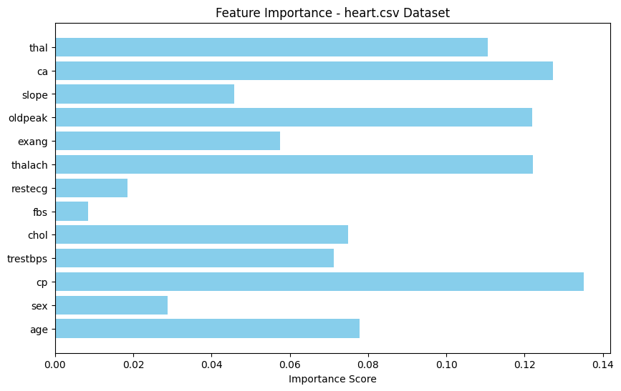
Feature Importance

Slide 25
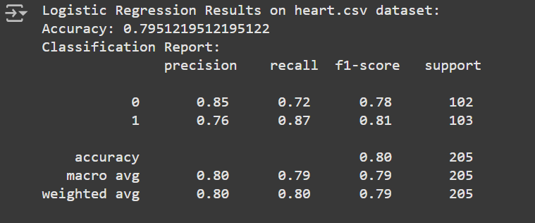
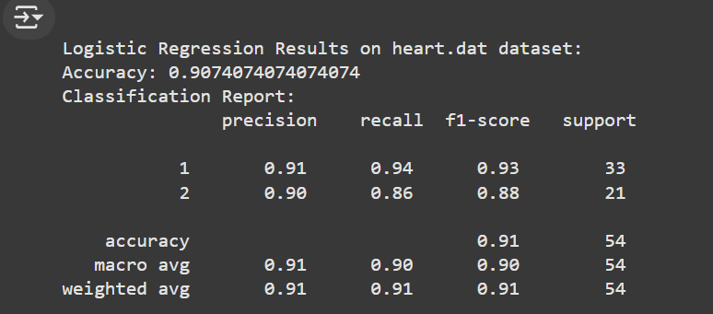

Slide 26
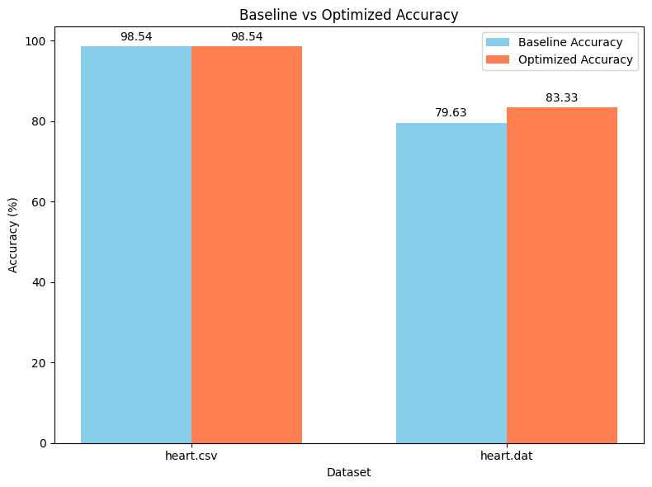
Model Performance Comparison
1. heart.csv Dataset:
Baseline Accuracy: 98.54%
Optimized Accuracy: 98.54% (No significant improvement due to already high baseline accuracy).
Precision, Recall, F1-Score: Consistently ~99% for both models.
2. heart.dat Dataset:
Baseline Accuracy: 79.63%
Optimized Accuracy: 83.33% (Moderate improvement after hyperparameter tuning).
Precision, Recall, F1-Score: Noticeable improvements in both classes.

Slide 27
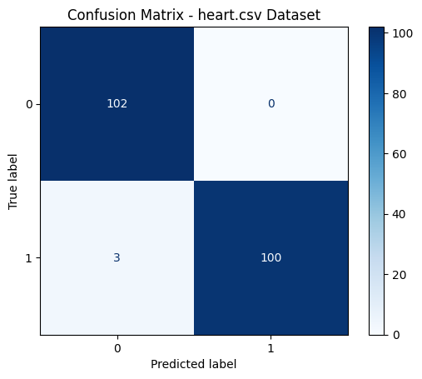
Confusion Matrix Analysis – heart.csv
Overview: The confusion matrix for the heart.csv dataset demonstrates high classification performance.
Details:
True Positive (TP): 100 instances of class 1 were correctly classified.
True Negative (TN): 102 instances of class 0 were correctly classified.
False Positive (FP): 0 instances were misclassified as class 1.
False Negative (FN): Only 3 instances of class 1 were misclassified.
Observations:
The results align with the high accuracy and F1-Score (~99%) observed previously.
Minimal classification errors indicate a well-represented dataset and effective feature encoding.

Slide 28
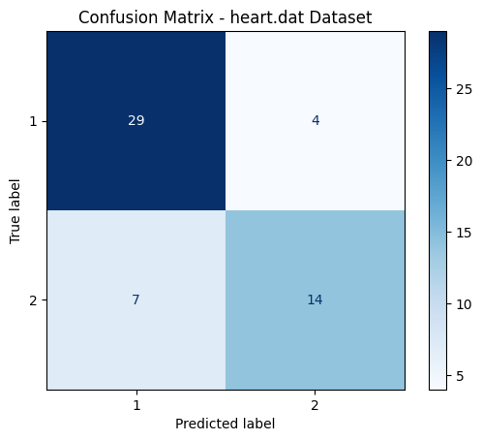
Confusion Matrix Analysis – heart.dat
Overview: The confusion matrix for the heart.dat dataset shows moderate classification performance.
Details:
True Positive (TP): 29 instances of class 1 were correctly classified.
True Negative (TN): 14 instances of class 2 were correctly classified.
False Positive (FP): 4 instances were misclassified as class 2.
False Negative (FN): 7 instances of class 2 were misclassified as class 1.
Observations:
The classification performance is affected by the smaller dataset size and potential class imbalance.
This aligns with the relatively lower accuracy and F1-Score compared to the heart.csv dataset.

Slide 29
Deep Learning Model - MLP Overview
1. heart.csv Dataset:
Model: Multilayer Perceptron (MLP)
Features: Encoded and standardized data.
Results:
Accuracy: 98.54%
Precision, Recall, F1-Score: Near 99% for both classes.
Observations:
High accuracy indicates that the MLP model performs equally well compared to Random Forest.
Deep learning models benefit from well-preprocessed and high-quality datasets.
2. heart.dat Dataset:
Model: Multilayer Perceptron (MLP)
Features: Encoded and standardized data.
Results:
Accuracy: 61.11%
Precision and Recall: Lower than heart.csv dataset.
Observations:
Moderate accuracy and poor F1-scores highlight challenges with small dataset size and class imbalance.
Deep learning models are more sensitive to imbalanced datasets.

Slide 30
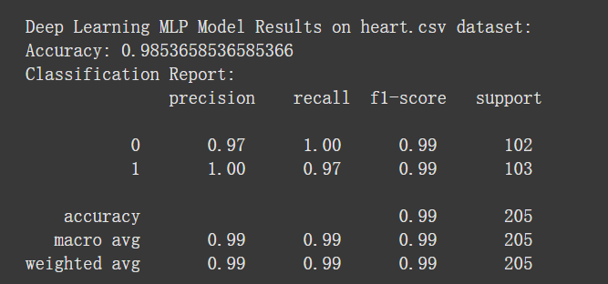
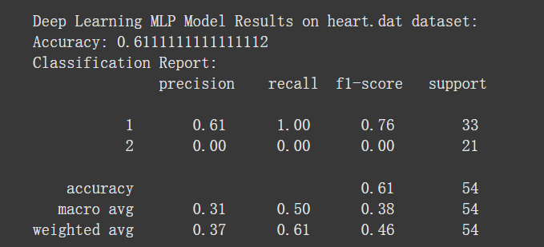

Slide 31
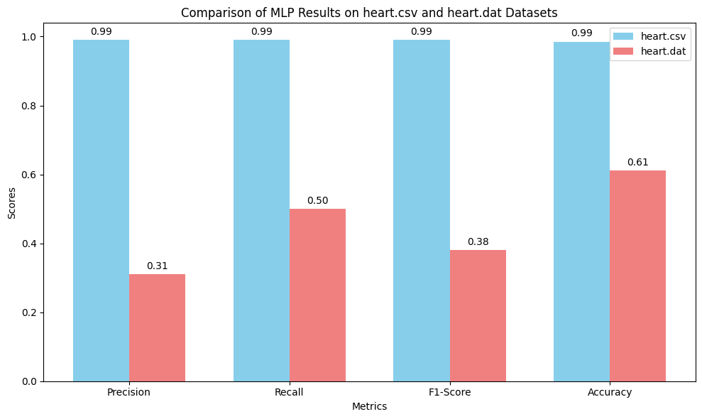
Comparison and Analysis of SVM Results on heart.csv and heart.dat Datasets
Performance Insights:
The heart.csv dataset demonstrates exceptional performance across all metrics, with values close to 0.99. This result highlights the dataset's balance and sufficient representation of classes, which align well with the model's learning capacity.
The heart.dat dataset shows moderate to poor performance, with an overall accuracy of 0.61. This is due to:
Class imbalance: Precision and recall are significantly lower for the underrepresented class (class 2).
Data size limitations: The smaller dataset size impacts the model's ability to generalize effectively.
Key Observations:
The stark contrast in precision (0.99 vs. 0.31) and recall (0.99 vs. 0.50) underscores the sensitivity of deep learning models to dataset quality and balance.
A significant drop in F1-score (0.99 vs. 0.38) for heart.dat further highlights the challenges posed by the dataset's limitations.
Conclusion:
The heart.csv dataset is highly suited for MLP models due to its well-processed and balanced nature.
For the heart.dat dataset, further preprocessing steps such as data augmentation, oversampling, or switching to models that handle imbalanced datasets more effectively should be considered.

Slide 32
Future Improvements and Strategies
heart.csv Dataset:
Current Challenges: Minimal, given its already high performance.
Possible Enhancements: Explore advanced models like Convolutional Neural Networks (CNNs) for potential marginal gains.
heart.dat Dataset:
Key Issues:
Class imbalance: Leads to poor recall and precision for the minority class.
Small dataset size: Limits the model’s ability to learn effectively.
Improvement Strategies:
Data Augmentation: Synthetic oversampling using techniques like SMOTE.
Alternative Models: Evaluate models like Gradient Boosting or ensemble methods.
Feature Engineering: Extract meaningful features to improve representation.
Next Steps:
Implement oversampling or synthetic data generation techniques.
Redesign the MLP architecture or adopt Transfer Learning methods.
Conduct cross-validation with larger folds for robust performance evaluation.

Slide 33
SVM Training and Evaluation Overview
1. heart.csv Dataset:
Model: Support Vector Machine (SVM) with RBF Kernel
Features: Standardized data
Results:
Accuracy: 88.78%
Precision, Recall, F1-Score: ~0.89 for both classes
Observations:
Balanced performance across both classes
Slightly lower performance compared to MLP due to simpler data representation
2. heart.dat Dataset:
Model: Support Vector Machine (SVM) with RBF Kernel
Features: Standardized data
Results:
Accuracy: 88.89%
Precision, Recall, F1-Score: ~0.88 for both classes
Observations:
Handles small dataset and class imbalance better than MLP
Still lower performance on minority class (class 2)

Slide 34
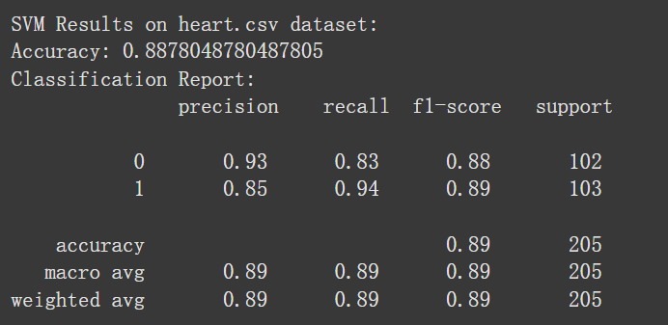
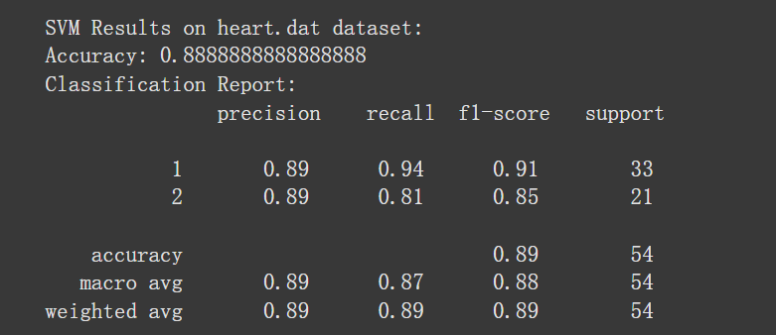

Slide 35
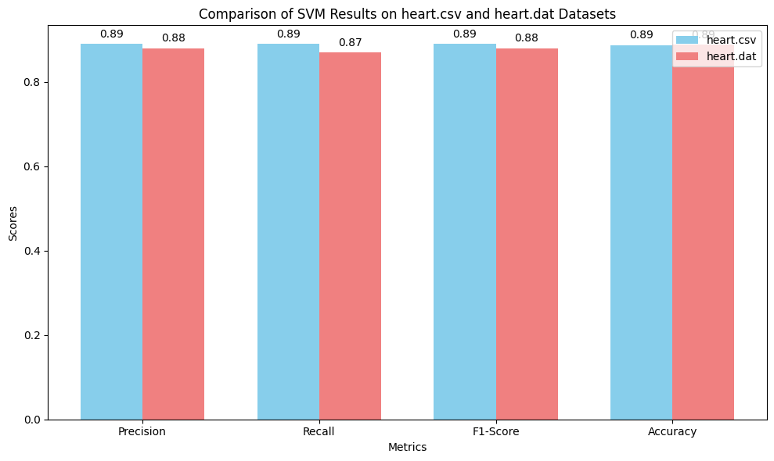
Comparison of SVM Results on heart.csv and heart.dat Datasets
Performance Insights:
heart.csv Dataset:
Accuracy: 88.78%
Precision, Recall, F1-Score: ~0.89 for both classes.
Observation: Balanced performance across both classes with slightly lower recall for class 0 (0.83).
heart.dat Dataset:
Accuracy: 88.89%
Precision, Recall, F1-Score: ~0.88 for both classes.
Observation: Handles small dataset and class imbalance better than MLP but still has lower recall for class 2 (0.81).
Key Observations:
Balanced Performance: SVM achieves similar accuracy (~88.8%) on both datasets.
Minority Class Challenges: Recall for class 2 on heart.dat remains lower, showing room for improvement in handling minority classes.
Comparison with MLP:
On heart.csv, MLP outperforms SVM significantly.
On heart.dat, SVM performs much better, showcasing its robustness with small, imbalanced datasets.

Slide 36
SVM Results Analysis
heart.csv Dataset:
Strengths:
Delivers balanced performance across both classes.
Achieves 88.78% accuracy, highlighting the effectiveness of SVM on larger, well-prepared datasets.
Limitations:
Slightly lower recall for class 0 (0.83), suggesting possible misclassifications.
Underperforms compared to MLP in terms of overall accuracy and F1-score.
heart.dat Dataset:
Strengths:
Performs better than MLP on small and imbalanced datasets, achieving an 88.89% accuracy.
Handles minority class 2 better than MLP, with a precision and recall of 0.89 and 0.81, respectively.
Limitations:
Still struggles with minority class recall, indicating room for further optimization or preprocessing.
Key Observations:
Balanced Performance: SVM provides consistent accuracy across datasets, proving its robustness for varied data sizes and distributions.
Comparison with MLP:
On heart.csv, MLP outperforms SVM, showcasing the potential of deep learning for well-represented datasets.
On heart.dat, SVM’s performance stability suggests it as a viable alternative when data is limited or imbalanced.

Slide 37
Future Improvements and Strategies
heart.csv Dataset:
Current Challenges:
Slightly lower recall for class 0 (0.83).
Underperforms compared to MLP in overall accuracy and F1-score.
Possible Enhancements:
Experiment with alternative kernels (e.g., polynomial, sigmoid) to improve performance.
Optimize hyperparameters like C and gamma using techniques such as GridSearchCV.
Incorporate feature selection or dimensionality reduction (e.g., PCA) to simplify the model.
heart.dat Dataset:
Key Issues:
Struggles with recall for the minority class (class 2).
Handles small datasets better than MLP but still has room for improvement.
Improvement Strategies:
Employ synthetic oversampling techniques like SMOTE to balance the classes.
Explore ensemble methods like Bagging or Boosting for enhanced performance.
Consider using SVM extensions like one-class SVM for better handling of imbalanced data.
Next Steps:
Conduct detailed cross-validation experiments to ensure robust performance across various folds.
Redesign the SVM pipeline with advanced preprocessing techniques tailored to each dataset.
Evaluate the impact of combining SVM with other classifiers in hybrid models.

Slide 38
Performance Summary: Baseline, Hyperparameter Tuning, MLP, and SVM Models
Model | Dataset | Accuracy | Precision | Recall | F1-Score | Observations
Baseline (RF) | heart.csv | 98.54% | ~99% | ~99% | ~99% | Exceptional performance, indicating high data quality and minimal class imbalance.
Baseline (RF) | heart.dat | 79.63% | ~79% | ~79% | ~79% | Moderate performance, affected by smaller dataset and class imbalance.
Hyperparameter Tuning | heart.csv | 98.54% | ~99% | ~99% | ~99% | No significant improvement due to already high baseline accuracy.
Hyperparameter Tuning | heart.dat | 83.33% | ~83% | ~83% | ~83% | Moderate improvement achieved with parameter optimization.
MLP | heart.csv | 98.54% | 0.99 | 0.99 | 0.99 | High accuracy, suitable for well-processed and balanced datasets.
MLP | heart.dat | 61.11% | 0.31 | 0.50 | 0.38 | Poor performance on imbalanced and smaller datasets; struggles with minority class recall.
SVM | heart.csv | 88.78% | 0.89 | 0.89 | 0.89 | Balanced performance, slightly lower than MLP, showcasing SVM's robustness on standardized data.
SVM | heart.dat | 88.89% | 0.89 | 0.87 | 0.88 | Better performance than MLP on imbalanced datasets; still limited in minority class recall.

Slide 39
Summary of Findings
Key Insights and Learnings
Overview of Results:
Baseline models (Random Forest) perform exceptionally well on heart.csv (Accuracy: 98.54%) but are moderately limited on heart.dat (Accuracy: 79.63%) due to dataset size and class imbalance.
Hyperparameter tuning shows limited improvement for heart.csv but provides moderate gains for heart.dat, indicating its potential for optimizing smaller datasets.
MLP excels in heart.csv, achieving near-perfect precision, recall, and F1-score (~0.99) but struggles significantly with heart.dat due to sensitivity to class imbalance and limited data.
SVM demonstrates robustness on both datasets, balancing performance across classes better than MLP on heart.dat (Accuracy: 88.89%).
Key Findings:
Dataset characteristics, including size and balance, play a critical role in model performance.
Models like MLP and SVM show strengths in specific contexts, emphasizing the importance of selecting appropriate algorithms for different data properties.

Slide 40
Implications and Future Directions
Implications for Model Selection and Future Work
Implications:
The performance gap between heart.csv and heart.dat highlights the importance of data preprocessing, including balancing classes and augmenting small datasets.
SVM's robustness on imbalanced data suggests it as a strong alternative when data quality is suboptimal, while MLP remains highly effective for balanced and well-processed datasets.
Future Work:
Dataset Improvements:
Implement advanced data augmentation strategies (e.g., SMOTE) to address class imbalance.
Increase dataset size by exploring additional data sources or generating synthetic data.
Model Enhancements:
Test advanced algorithms like Gradient Boosting, XGBoost, or ensemble methods for comparison.
Explore transfer learning techniques, especially for small datasets like heart.dat.
Pipeline Refinement:
Conduct detailed cross-validation experiments to validate model robustness.
Automate hyperparameter tuning to ensure optimal performance across various conditions.

Slide 41

Thank you
References:
Gurpreet Singh, Amanda Gonslaves, Fadi Thabtah, Rami Mustafa Mohammad. (2019). Prediction of Coronary Heart Disease using Machine Learning: An Experimental Analysis. In ICDLT ’19: Proceedings of the 2019 3rd International Conference on Deep Learning Technologies
GitHub: https://github.com/hoganleu/Machine-Learning

